Slide 1
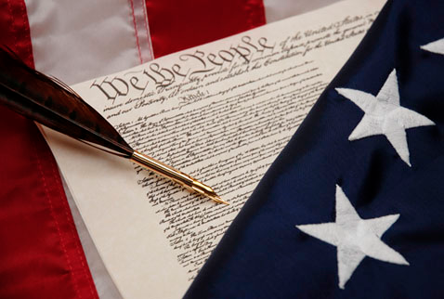
Civics in One Day
What do those seven articles really say?

Slide 2
9th Amendment
The enumeration in the Constitution, of certain rights, shall not be construed to deny or disparage others retained by the people.

Slide 3
10th Amendment
he powers not delegated to the United States by the Constitution, nor prohibited by it to the States, are reserved to the States respectively, or to the people

Slide 4
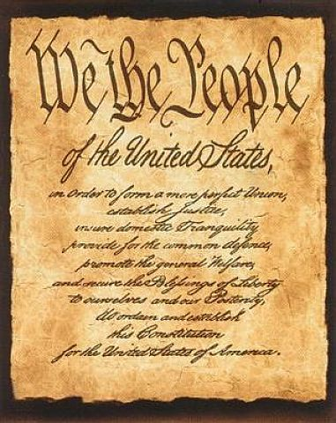
Preamble
Purpose of Constitution, govt. est. by people

Slide 5
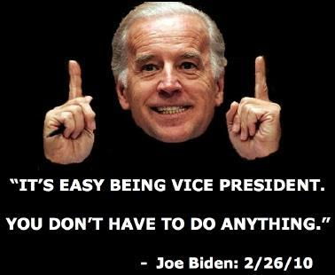
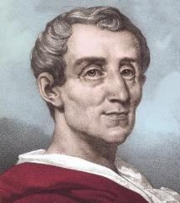
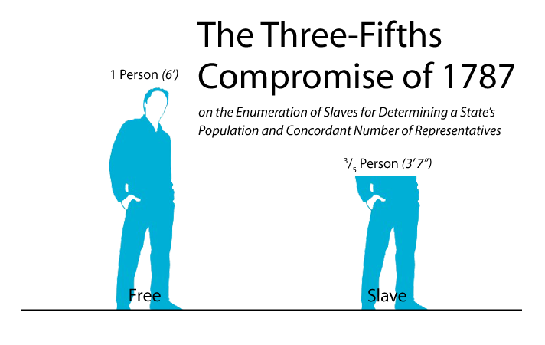
Article I: Legislative
Separation of powers; Baron de Montesquieu’s The Spirit of the Laws
Art. 1, sect. 2.3 – basis of 3/5 compromise
Art. 1, sect. 3.1 – originally state leg. Choose senators, amendment 17 made it direct
Art. 1, sect. 3.4 – Constitution gives VP only 2 responsibilities: pres. of Senate and vote in case of tie
Art. 1, sect. 3.6 – 2/3 of senate have to vote for conviction of impeachment
Monty

Slide 6
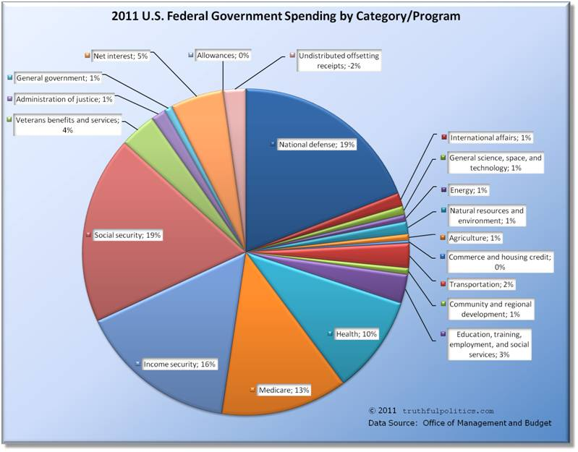

Art. 1, sect. 7 – Revenue bills must begin in House; power of purse strings in lower legislature, grows out of colonial period
Art 1, sect. 8 – Delegated powers/enumerated powers
sect. 8.3 – Commerce Clause
sect. 8.11 – 1973 War Powers Resolution – Gives president power to send troops abroad in emergency cases for 60 days (end hostilities)
sect. 8.18 – Necessary and Proper Clause – elastic clause/implied powers

Slide 7
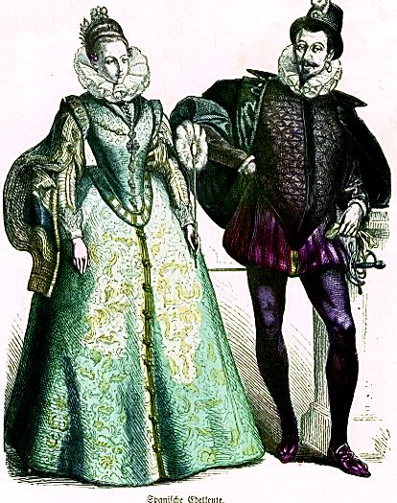
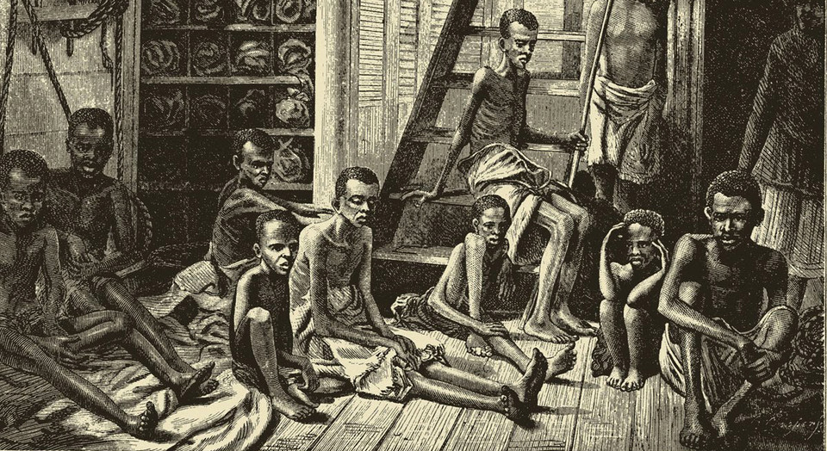

Art. 1, sect. 9 – Powers denied to the Federal govt.
sect. 9.1 – Importation of slavery illegal after 1808
sect. 9.2 – Can't be jailed without sufficient evidence; writ of habeas corpus
sect. 9.3 – No ex post facto laws/no bill of attainder--no punishment w/out jury trial
sect. 9.5 – No tax on exports
sect. 9.7 – Limits presidential power by giving Congress appropriations
sect. 9.8 – No establishment of nobility
X
X
X

Slide 8
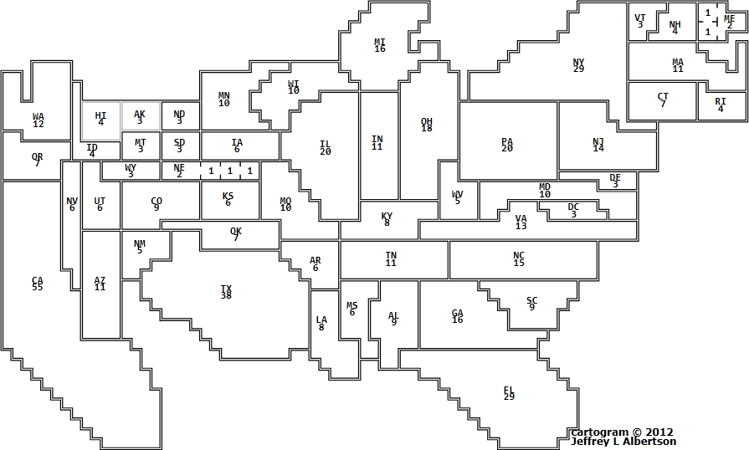
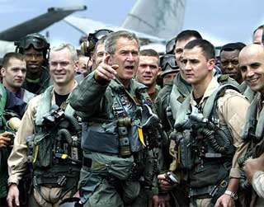
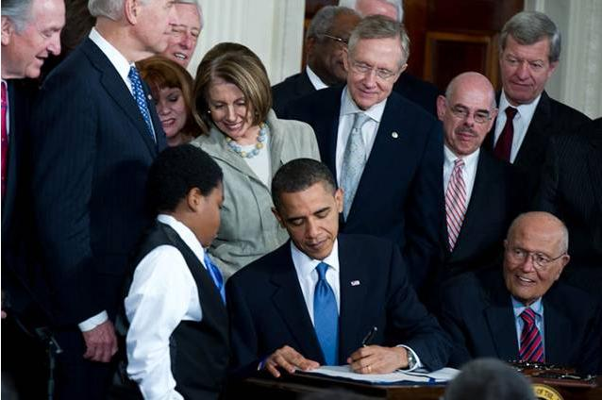
Article II: Executive
Art. 2, Sect. 1.3 – Electoral college est. to safeguard against oligarchy (state leg. originally elected e.c.)
Art. 2, sect. 2 – Military under civilian control
Art. 2, sect. 3 – Presidential duties
Legislative – Setting agenda, signing/vetoing bills, special sessions of Congress; executive orders
Diplomatic
Executive – Setting up depts/agencies & filling positions
Military – Commander in Chief

Slide 9
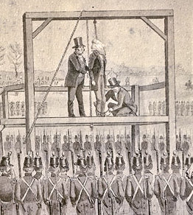
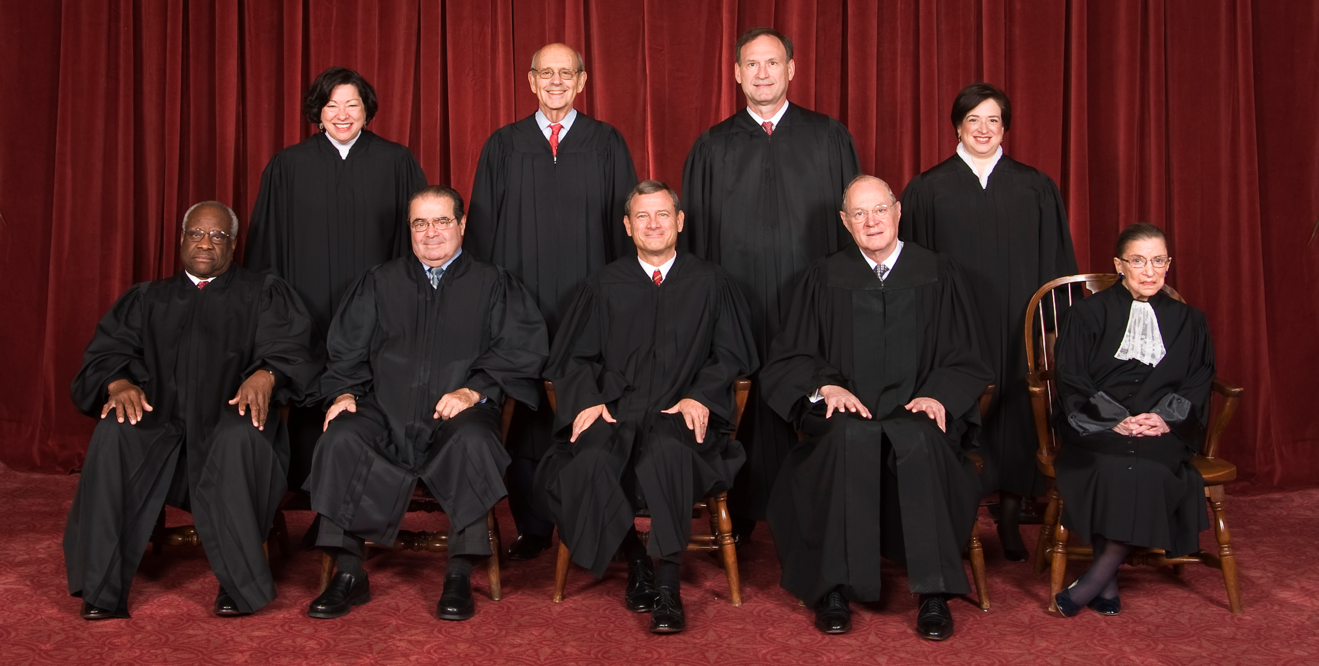
Article III: Judicial
Art. 3, sect. 1 – Only Supreme Court set up in Const.; congress created Court of Appeals and District Courts
Art. 3, sect. 3 – Treason is the only crime specifically mentioned in the Constitution

Slide 10
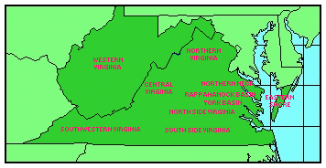

Relations Among the States
Art. 4, sect. 2.3 – Fugitive Slave Law (slaves should be returned to their owners)
Art. 4, sect. 3 – New states have same rights as the old; no new states created within borders of old (W. VA exception)

Slide 11
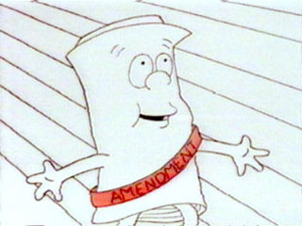
Article V: Amendments
27 amendments thus far
Two methods of proposal
a. 2/3 vote in both House and Senate
b. 2/3 of the state legislatures request congress to call Const. Conv.
Two methods of approval
a. ratified by 3/4 of all state legislatures
b. majority vote in 3/4 of state conventions

Slide 12
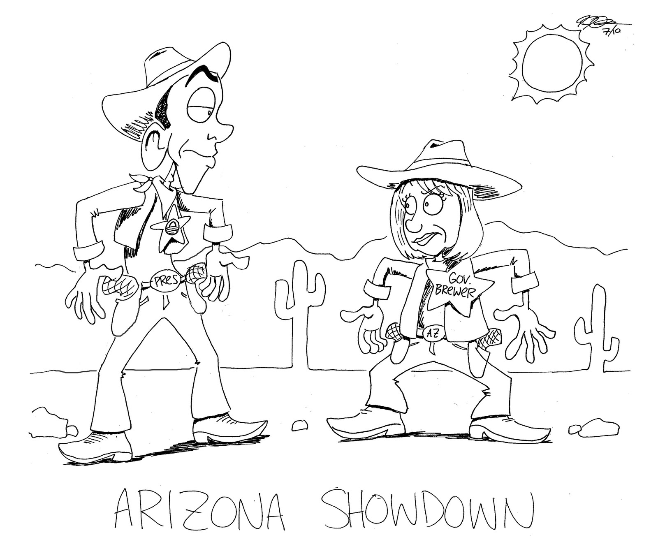
Article VI: Other Important Stuff
Art. 6, sect. 1 – Federal govt. assumes debts incurred under Articles of Confederation (Reset Button)
Art. 6, sect. 2 – Supremacy clause; national govt. has more power than state govt.

Slide 13
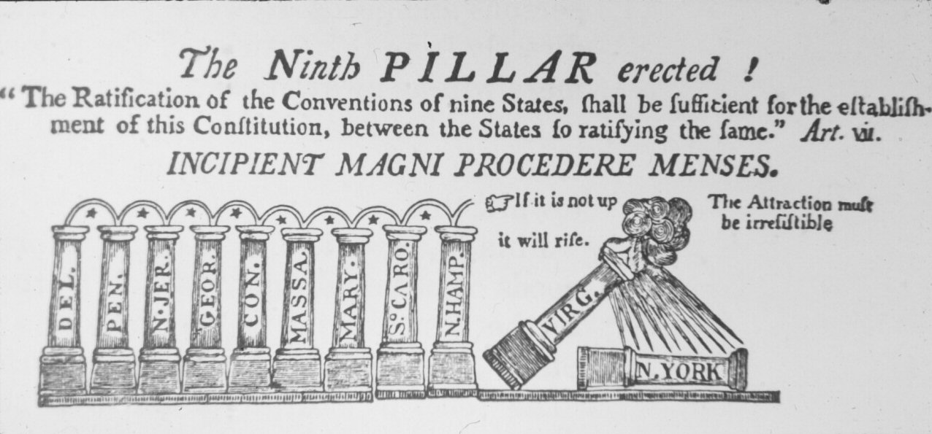
Article VII: Ratification
6/21/1788 by 9 states; VA, NYC, NC, RI follow by 1790.
Unlike AoC which said all 13 states had to amend it; Rhode Island states Const. was amended by revolutionary means.
Oldest operating constitution in the world

Slide 14
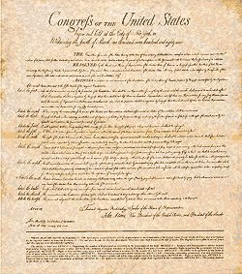
Bill of Rights
First 10 Amendments (1791)

